Slide 1
Data Driven recommendation
G2M INSIGHT FOR CAB INVESTMENT FIRM
Data Glacier Virtual Internship
Submitted by: Ankita Manna

Slide 2
Objective:
Provide actionable insights to help XYZ firm to identify the right company for investment

Slide 3
Steps:
Overview of Dataset
Descriptive statistics
Company wise Financial overview
City wise Financial overview
Time wise Analysis
Hypothesis Testing
Recommendation

Slide 4
Overview of Dataset
Cab_Data.csv – this file includes details of transaction for 2 cab companies. This dataset has 359392 records and 7 features that provides details of travel date, city of travel, km travelled etc.
Customer_ID- this is a mapping table that contains a unique identifier which links the customer’s demographic details.
Transaction_ID.csv – this is a mapping table that contains transaction to customer mapping and payment mode
City.csv – this file contains list of US cities, their population and number of cab users

Slide 5

Exploratory Data
Analysis

Slide 6
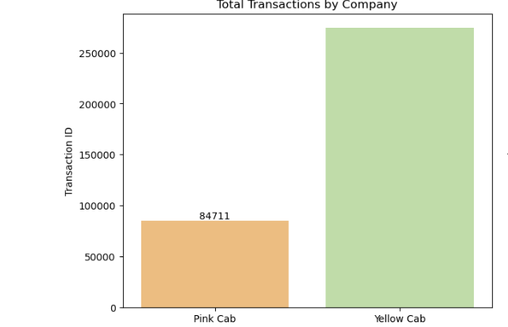
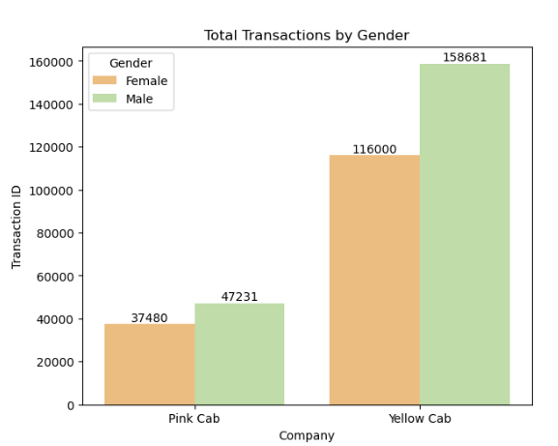
User Engagement
Which company has more user?
Insight from Gender distribution
Yellow Cab dominates interms of total transaction.
Numbers of male Customer are significantly higher for yellow car, where as for pink cab it gap is negligible.

Slide 7
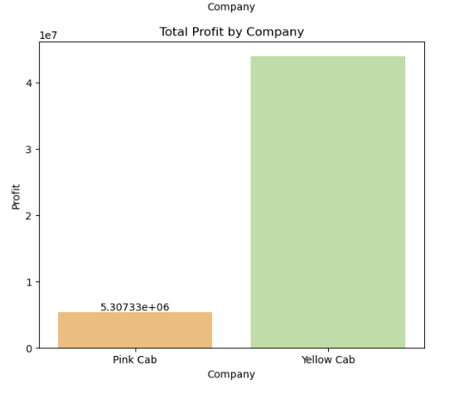
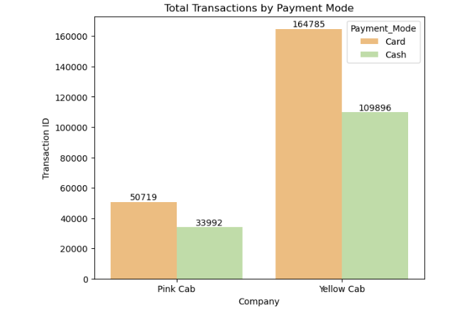
Profit
What is the preferred method of payment?
Which company has more profit?
Yellow Cab has higher profit margin than pink cab
With the growing usage of digital Technology, customers have preferred card payment instead of cash.

Slide 8
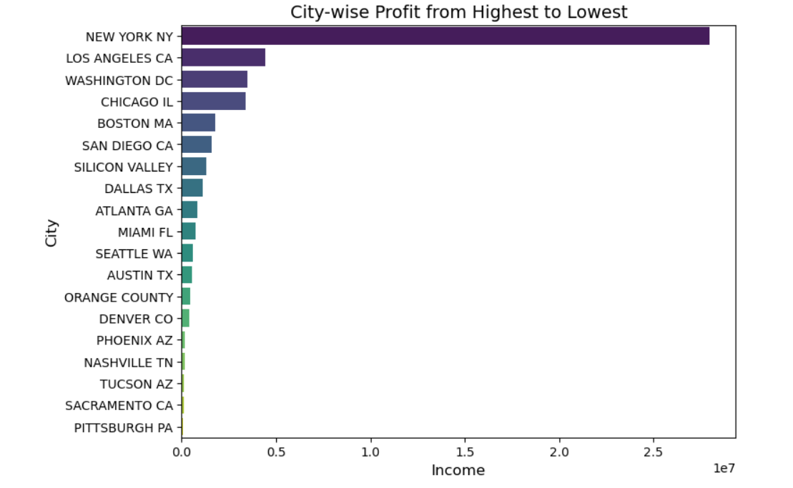
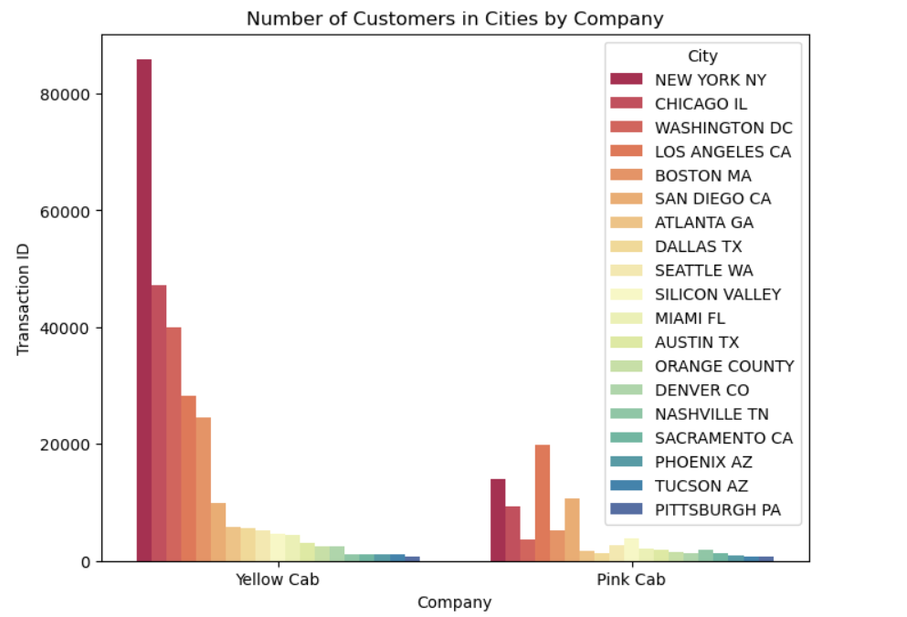
CITY WISE OVERVIEW
Which City has most profit?
Which City has most Customer?
In terms of profit, Newyork is far ahed becoming the most profitable city leading the second place by five times.
Likewise profit, Newyork has highest numbers of customers.

Slide 9
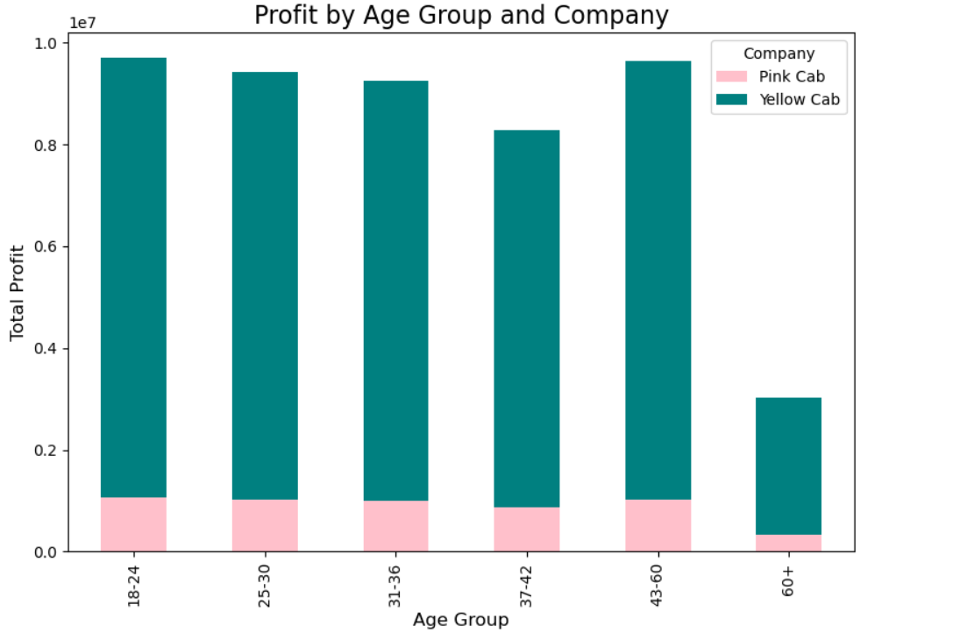
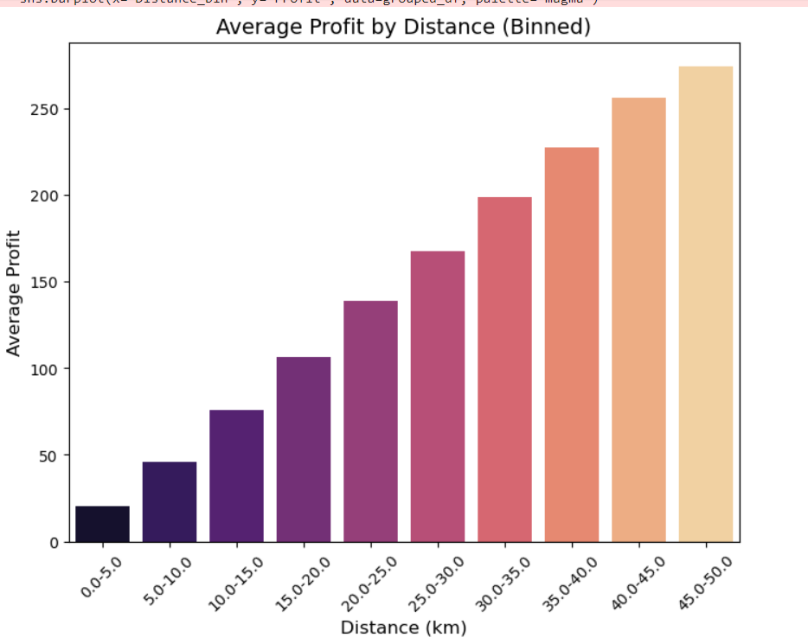
Profit vis age group &distance
How did profit change with distance ?
Which age group contributed most in the profit?
Yellow Cab has higher profit margin than pink cab
Profit varied proportionally with distance travelled. Longer the distance travelled, higher is the profit.

Slide 10
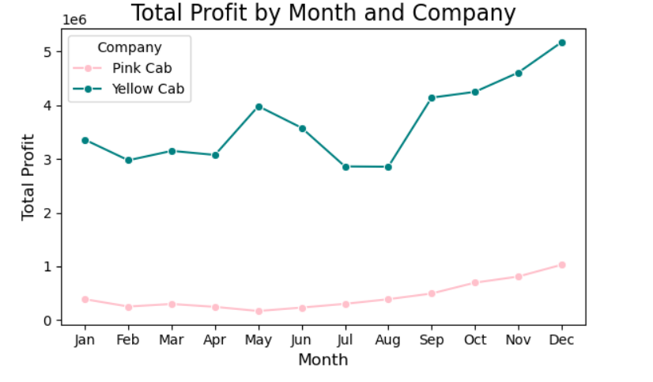
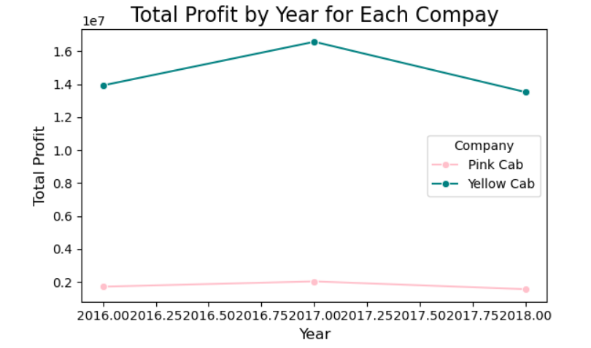
Profit ,mergin wrt time
Profit varies with month, which is highest in the December month, Christmas vacation might be a reason.
From 2016-2017, profit gradually increases. In 2017 profit was highest, 2018 profit decreased. Higher fuel price might be a reason for this decline.

Slide 11
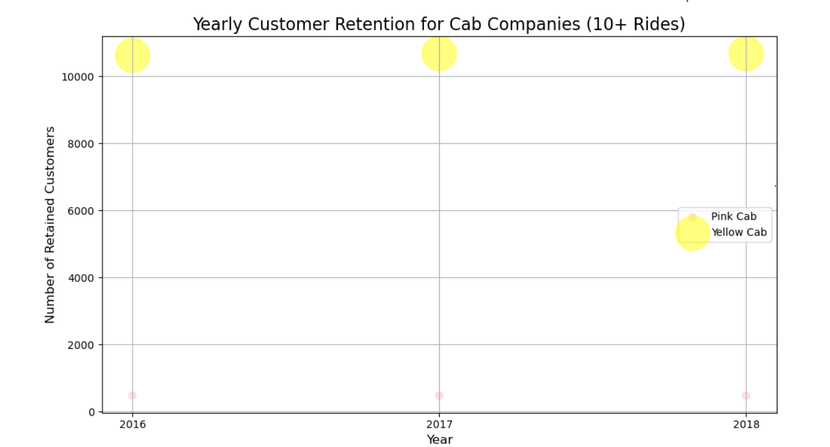
Customer retention
This graph shows the customer retation of each year for two given companies. The size of the bubble indicates the retention number. That indicates, customer retention of yellow cab is much higher than pink cab.

Slide 12

Hypothesis Testing

Slide 13

Gender preferences hypothesis
Hypothesis 1: Does the profit for a cab company differ significantly between male and female users? This examines if gender plays a role in the profit.
Hypothesis
Null Hypothesis (H0): There is NO significant difference in the mean of profit between male and female users. Gender does not play a role in the profit.
Alternative Hypothesis (H1): The profit for a cab company differs significantly between male and female users, indicating that gender plays a role in profit
Result:
Interpretation:
As p value is >0.05, we cannot reject the null hypothesis. There is significant association between profit and gender choices.

Slide 14
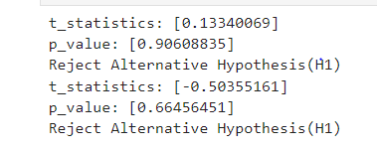
Age group preferences hypothesis
Does the profit for a cab company differ significantly between different age groups? This examines if age plays a role in the profit.
Hypothesis
Null Hypothesis (H0): There is NO significant difference in the mean of profit between younger (<50) and older (>50) users. Age groups do not play a role in the profit.
Alternative Hypothesis (H1): The profit for a cab company differs significantly between younger and older users, indicating that age groups play a role in profit.
Result
Interpretation:
As p value is >0.05, we cannot reject the null hypothesis. There is no significant association between profit and age group.

Slide 15
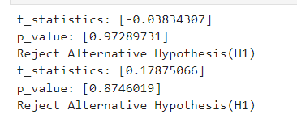
Payment Method preferences hypothesis
Does the profit for a cab company differ significantly with method of payments? This examines if payment method plays a role in the profit.
Hypothesis
Null Hypothesis (H0): There is NO significant difference in the mean of profit between card and cash payment users. Payment method does not play a role in the profit.
Alternative Hypothesis (H1): The profit for a cab company differs significantly between card and cash payers, indicating that payment method plays a role in profit
Result
Interpretation:
As p value is >0.05, we cannot reject the null hypothesis. There is no significant association between profit and payment choices.

Slide 16
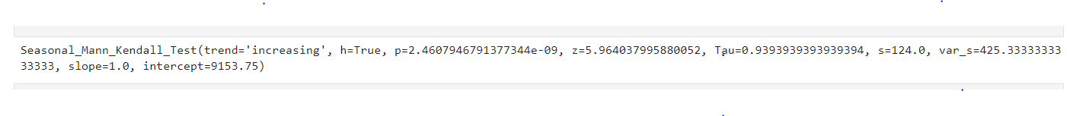
Hypothesis of profit with seasonality
Does the profit for a cab company differ significantly with seasonality
This examines if there is any seasonal change of profit with months?
Hypothesis
Null Hypothesis (H0): Profit does not depend on month
Alternative Hypothesis (H1): The profit for a cab company differs significantly with months.
Result
Interpretation:
As p value is <0.05, There is strong evidence to reject the null hypothesis. The results of the Seasonal Mann-Kendall Test suggest that there is a strong, statistically significant increasing trend in the number of customers over the months examined

Slide 17

Hypothesis of Cab preference with income
Does the preference for a cab company differ significantly with income variatio
Hypothesis
Null Hypothesis (H0): cab choice does not depend on income
Alternative Hypothesis (H1): Preferece of cab depends on income.
Result
Interpretation:
As p value is >0.05, we fail to reject the null hypothesis. There is no significant evidance that can prove dependency cab preference depends on average income. There is no significant difference in average income for cab users.

Slide 18
Conclusion

Slide 19
insights:
A thorough analysis was performed for the two companies, such as profitabiliy, demographic preferences, user preferences, seasonal analysis. Yellow Cab's dominance in user preferences ,profitability and customer retention is clear, yet this alone doesn't provide a full picture of company performance. Critical factors such as operational efficiency, customer satisfaction, service quality.

Slide 20
suggestion
Compared to Yellow Cab presents an attractive investment opportunity based on profitability, demographic preferences, user preferences.
Based on Seasonal analysis, winter season is most profitable time to invest.
City wise performance highlights New york, Los Angels, Washington DC are the most profitable cities to invest.
But before making a definitive investment decision, the firm should seek further information on customer satisfaction and service quality. These factors are pivotal in assessing the long-term sustainability and growth potential of both companies.

Slide 21
Thank you

